Slide 1



Computed Tomography (CT)
Morteza Esmaeili
MTE200, H2024

Slide 2
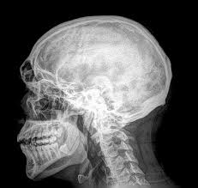
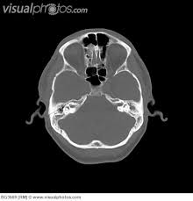
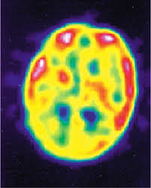
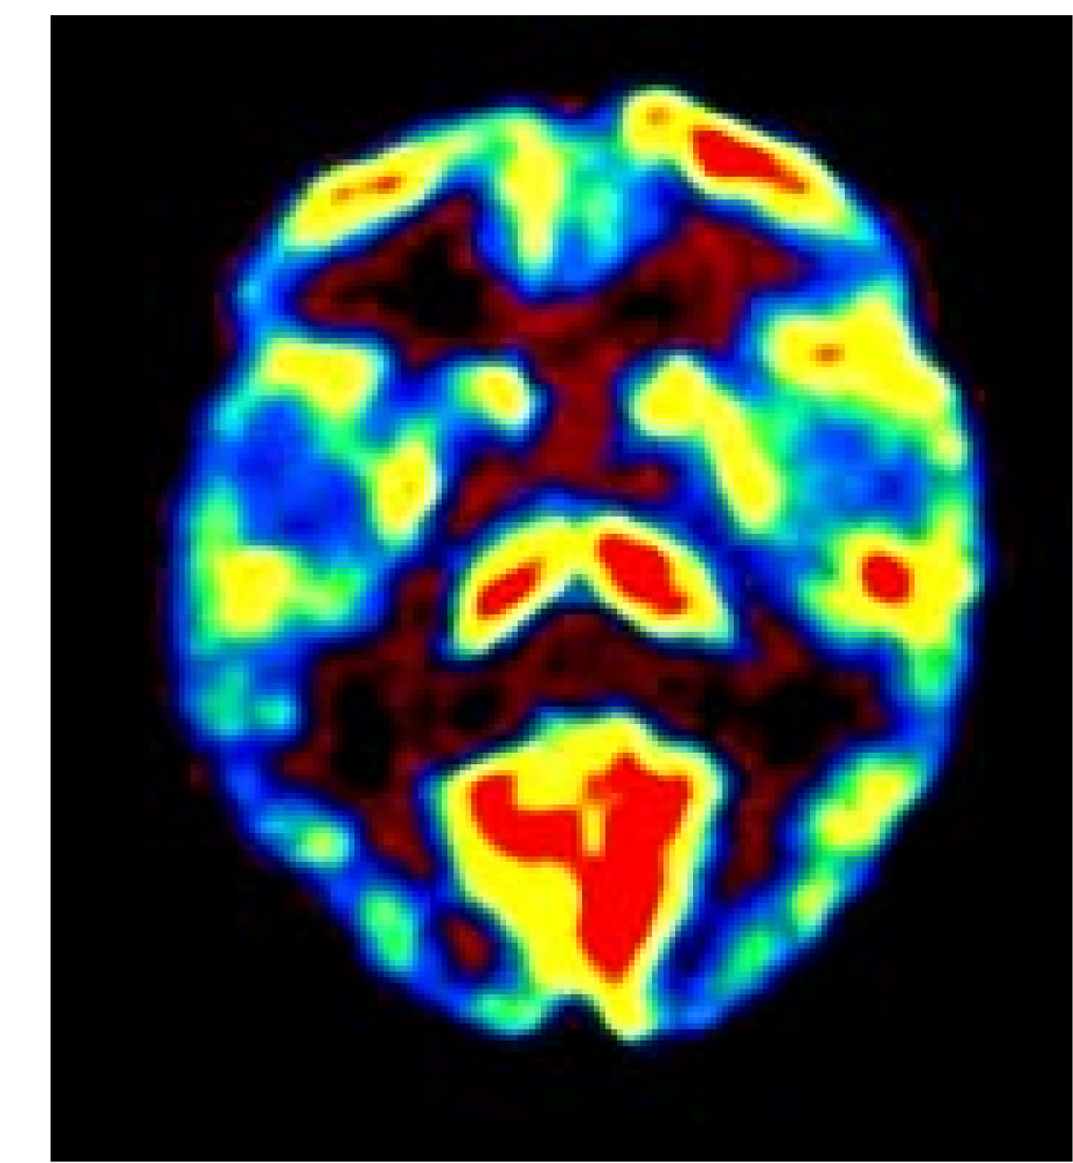
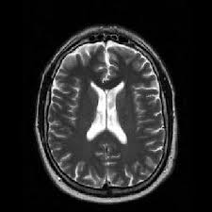
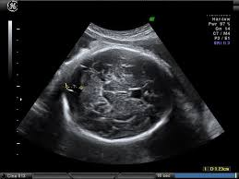
X-rays
Radiography
Computed Tomography (CT)
Ɣ-rays – nuclear medicine
Single Photon Emission Tomography (SPECT)
Positron Emission Tomography (PET)
Non-ionizing radiation techniques
Magnetic Resonance Imaging (MRI)
Ultrasound Imaging

Slide 3
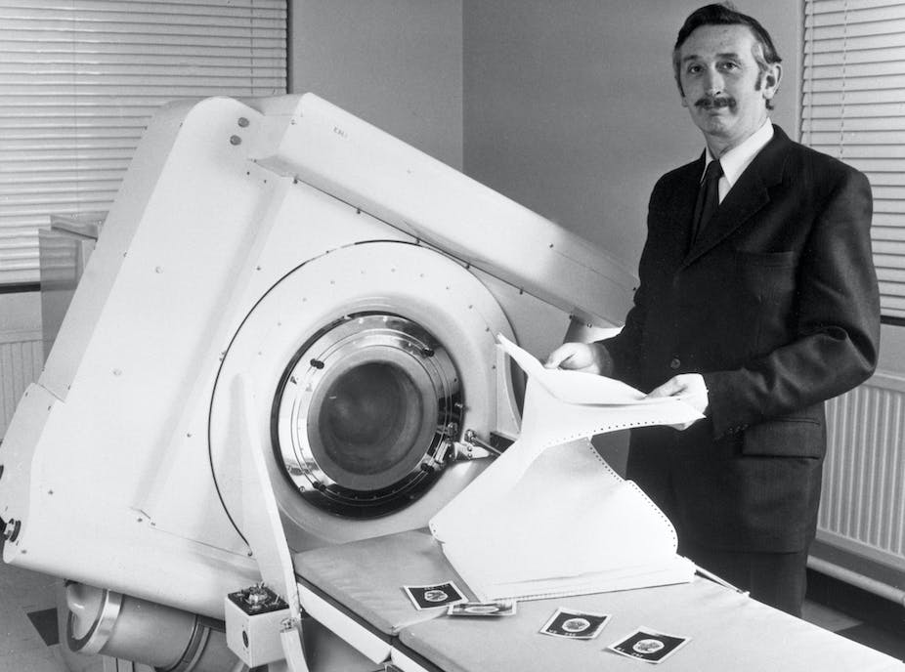
Computed Tomography (CT)
Uses X-ray in a circular rotational source(s) to create 3-dimensional images in slices
Computed axial tomography (CAT) scanning was invented by Godfrey N. Hounsfield in 1972 and independently by Alan Cormack in 1972.
Hounsfield’s CT scanner took several hours
to acquire data and days to reconstruct
a single image
Godfrey Hounsfield stands beside the EMI-Scanner in 1972.
PA Images via Getty Images

Slide 4
Rotating tubes
Table moves through a circular opening in the CT scanner called the gantry
X-ray tube(s) emits x-rays as it spins 360 degrees inside the gantry
A detector array measures the amount of x-rays that pass through the body
Computed tomography includes the capability of producing axial tomograms

Slide 5
Common applications
Detect and confirm the presence of tumor
Guide a biopsy
Plan and monitor radiation and surgical treatment
Diagnose problems with blood vessels and the heart
Diagnose abnormalities in:
Brain, nasal passages, musculoskeletal system, spine, abdomen, lungs, and mediastinum

Slide 6
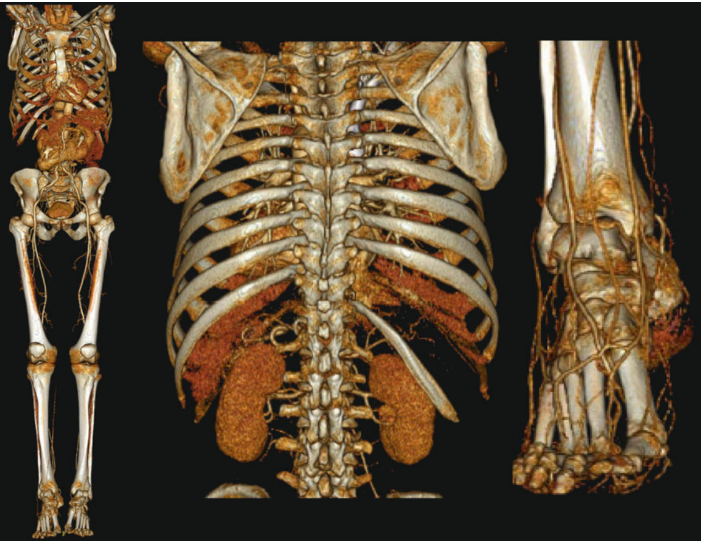
courtesy Philips Medical Systems
Notes:
Whole-body scans can be performed with the latest generation of CT systems, including multislice detector systems.
Even very small vessels of the feet can be precisely visualized (courtesy Philips Medical Systems)

Slide 7
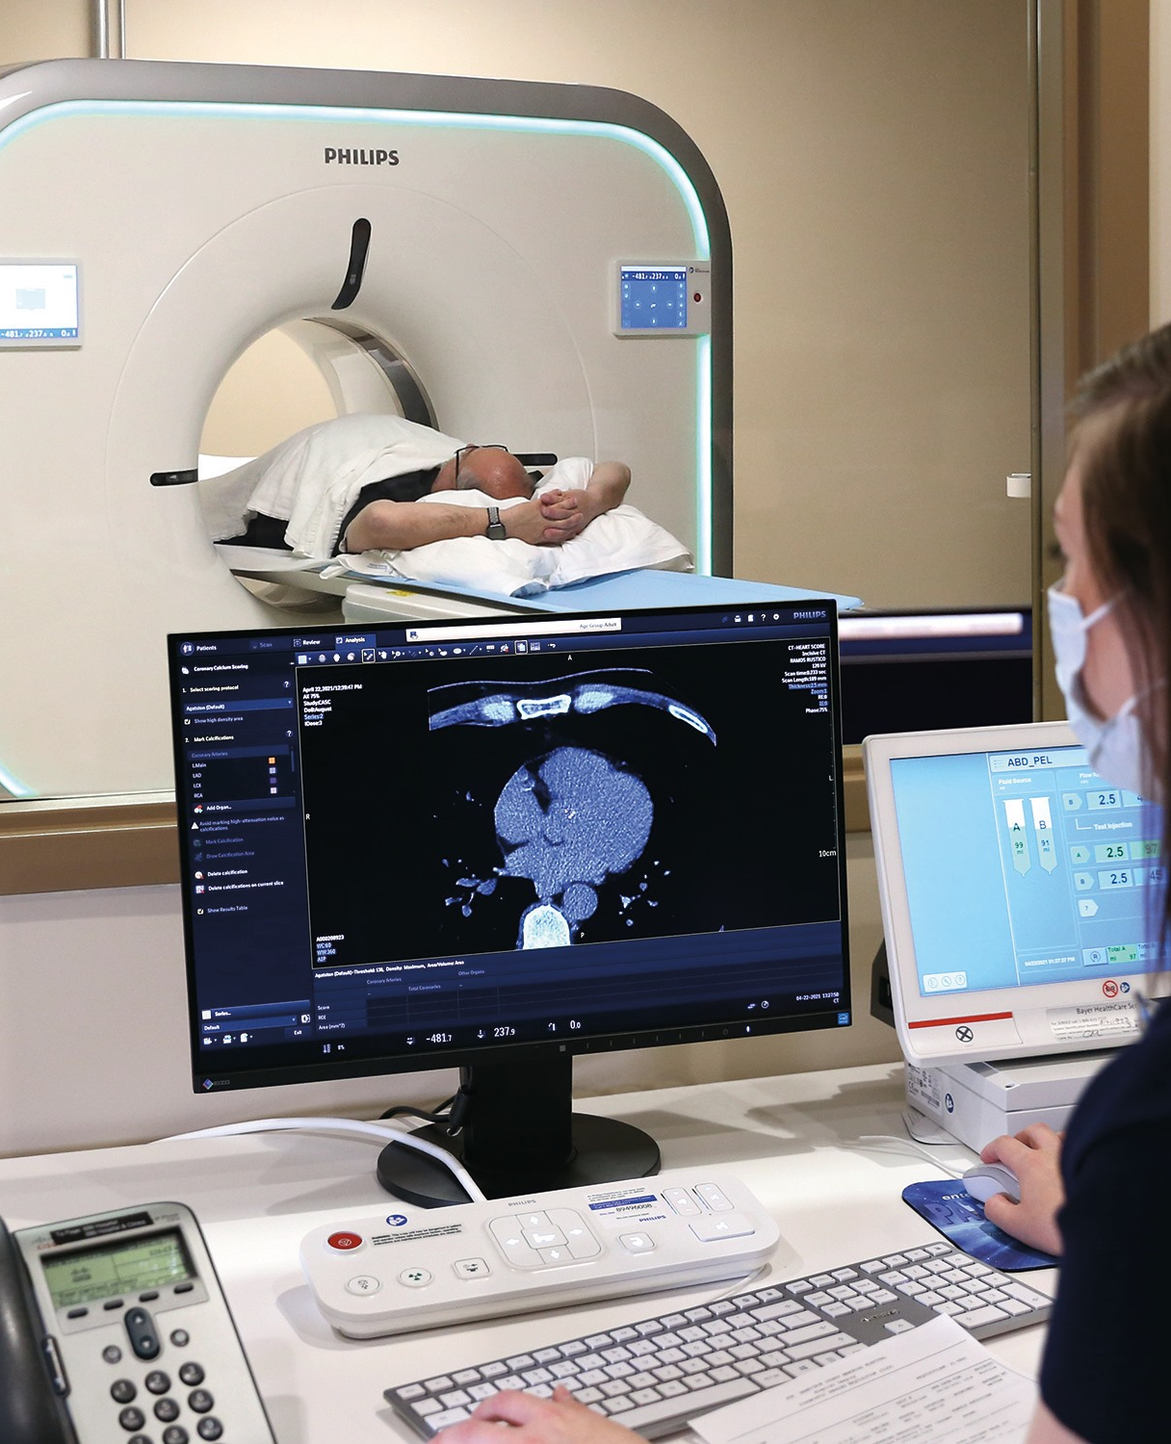
Commercial CT
Siemens introduced the first commercial CT system in May 1974
Early systems could scan in several minutes with a relatively longer reconstruction time
CT equipment was relatively large, stationary, and relatively expensive to operate

Slide 8
Multi-slice CT
The latest multi-slice CT systems can image an entire chest in less than ten seconds and reconstructs the images in a similar time period
Faster systems
Higher volume of patients
Enables development of new techniques

Slide 9
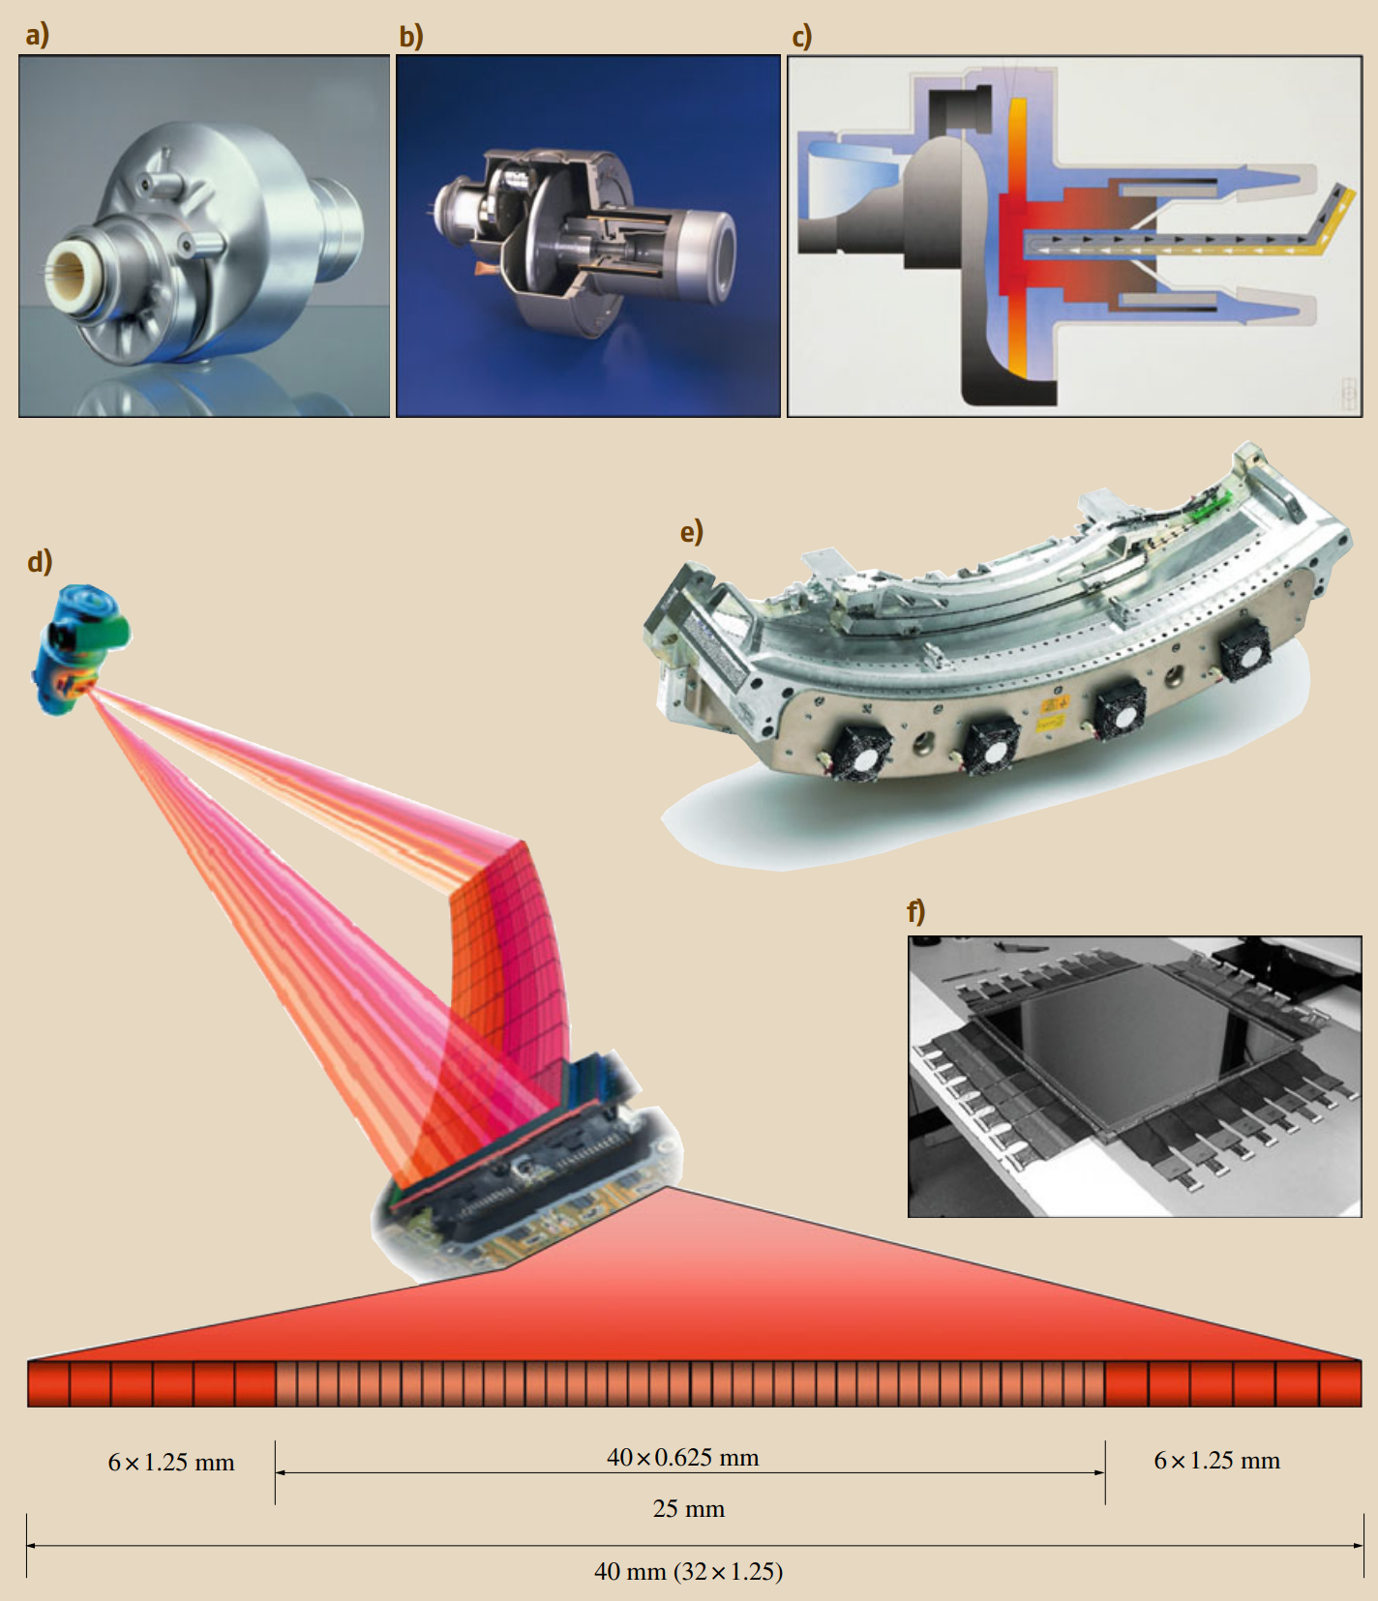
Notes:
Modern high-power x-ray tube (a,b) and schematic illustration of a modern x-ray tube with a rotating anode disk (c), schematic illustration of a multislice detector (d), a detector unit Solid-State Multislice Detectors of a 64-row CT system (e), and the realization of a 41 × 41 cm2 flat-panel detector with 2048 × 2048 pixels (f).

Slide 10
Technology evolution
The evolution of CT scanners has resulted from improvements in:
X-ray tube performance
Scan times
Image-reconstruction time
Reduction and, in some cases, elimination of image artifacts
Reduction in the amount of radiation exposure to patients
Notes:
Since its introduction, computerized tomography has undergone continuous refinements. The manufacture of quality CT systems requires a strong base in x-ray technology, physics, crystallography, electronics, and data processing
Achievements in these areas have focused attention on two key issues.
The first is image quality and its relationship to diagnostic value.
The second is scanner efficiency and its relationship to patient care and the economic impact it entails.
In order to attain a better understanding of the operation and utility of present CT systems, it is important to understand some of the evolutionary steps.

Slide 11
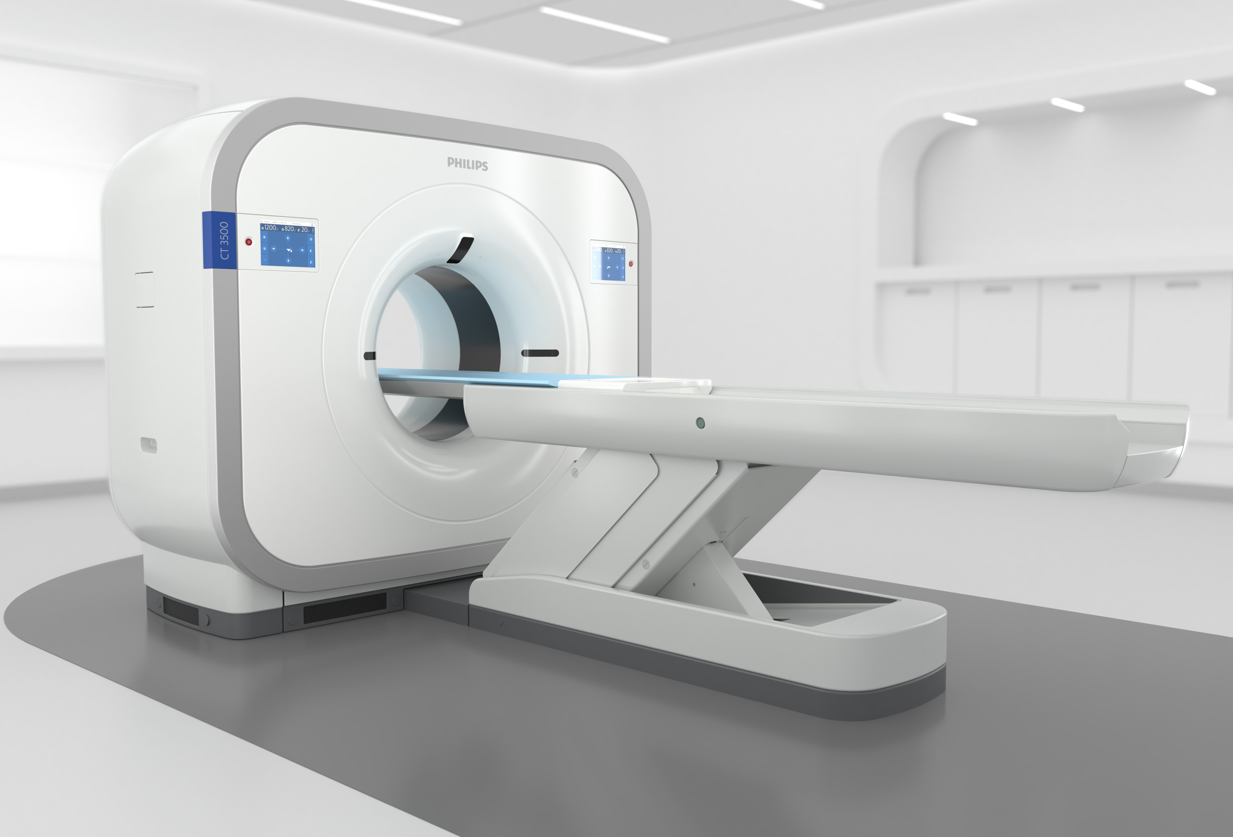
Major elements
The scanning gantry
The data-handling unit
A storage facility
Notes:
1. The scanning gantry, which takes the readings in a suitable form and quantity for a picture to be reconstructed.
2. The data-handling unit, which converts these readings into intelligible picture information, displays this picture information in a visual format, and provides various manipulative aids to enhance the image and thereby assist the physician in forming a diagnosis.
3. A storage facility, which enables the information to be examined or reexamined at any time after the actual scan

Slide 12
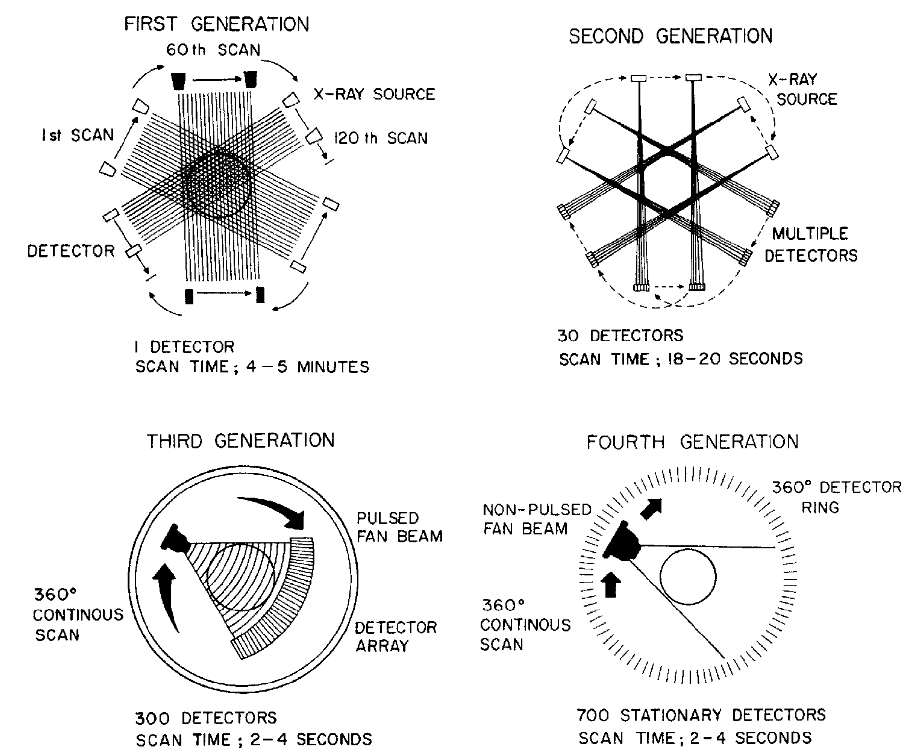

Slide 13
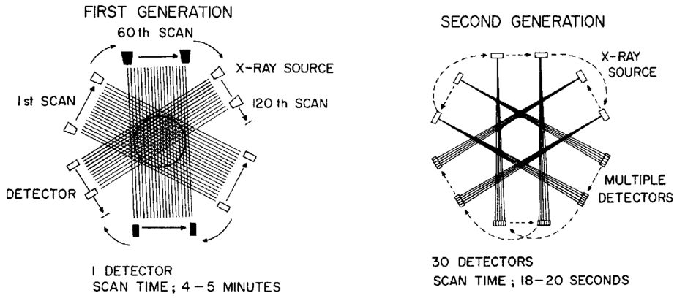
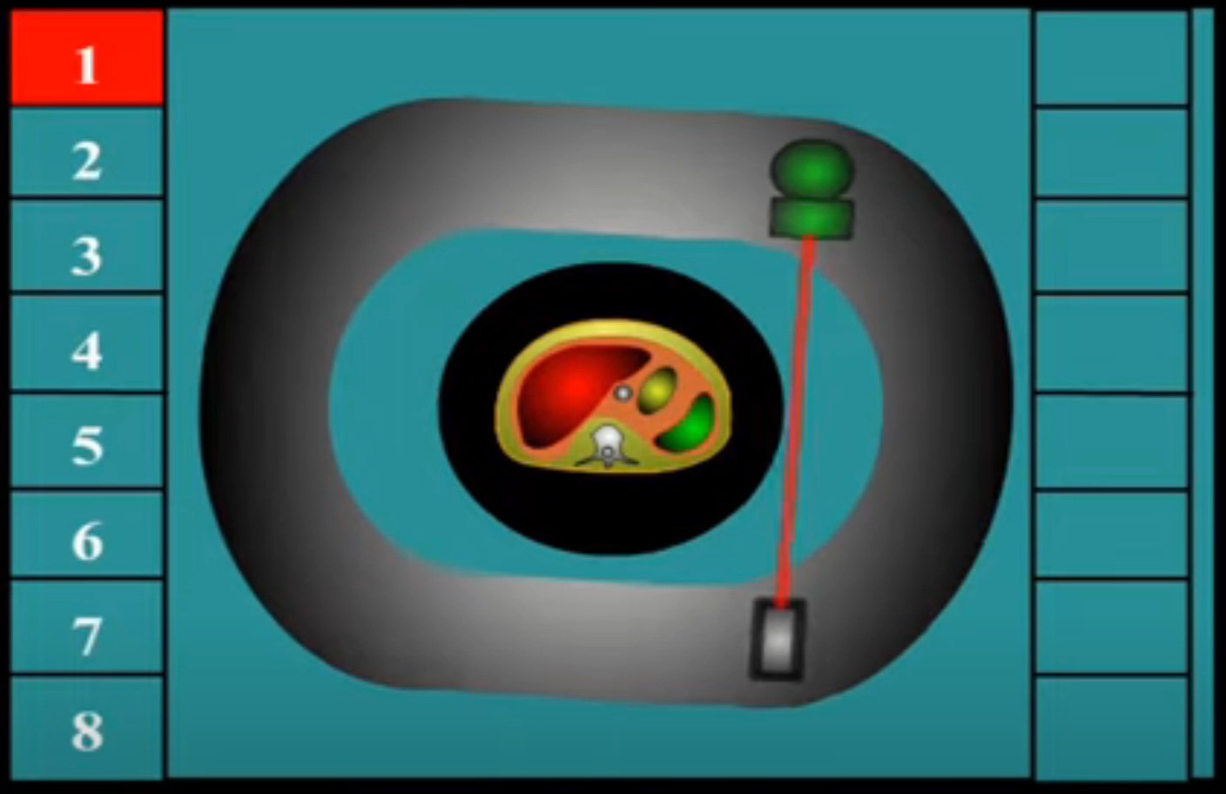

Slide 14
Notes:
Third generation of gantries consisted of a pure rotational system.
The source-detector unit had a pulsing, highly collimated wide angle (typically, 20–50 ) fan beam, and a multiple detector array was rotated 360 around the patient.
This single 360 smoothly rotating movement produced scan times as low as 500 ms, increased appreciably the reliability of the data because they were taken twice and increased the quality of the reconstructed image.
A by-product of this design was that the pulsing x-ray source could be synchronized with physiologic parameters, enabling rhythmic structures such as the heart to be more accurately imaged.
The main advantages of this type of system were its simplicity and its speed, but it had two major disadvantages.
First, its fixed geometric system, with a fan beam usually established for the largest patient, was inefficient for smaller objects and in particular for head scanning.
Second, it was particularly prone to circular artifacts.
These “ring” artifacts were most obvious in early pictures from this type of machine.

Slide 15
Notes:
Fourth-generation gantry system consisting of a continuous ring (360 ) of fixed detectors (usually numbering between 600 and 4,800) was developed.
In this system, the x-ray source rotated as before, and the transmitted x-rays were detected by the stationary detector ring.
The fan beam is increased slightly so the detectors on the leading and trailing edge of the fan can be continuously monitored and the data adjusted in case of shifts in detector performance.
Fourth-generation scan times of approximately 500 ms or less with reconstruction times of 30 seconds or less are now commonplace.
The development of high-voltage slip rings has enabled third- and fourth-generation scanners to continuously rotate about the patient.
By moving the patient couch at a uniform speed in or out of the scan plan, the x-ray beam will describe a helix or spiral path through the patient.
Slice widths of 1–10 mm and pixel matrixes up to 1,0242 may be employed, and typically a 50-cm-long volume can be imaged in a single breath hold.
Because of improvements in x-ray tube technology, spatial and contrast resolution are maintained.
New display techniques allow for real-time 3D manipulations and virtual reality fly-through of tubular structures such as the aorta or large intestine.

Slide 16
Data Acquisition, Timing & Transfer
Data Acquisition - measuring x-ray absorption
Data Timing - inherent in sampled (analog-to-digital) systems, determines image quality
Data Transfer - moves data from A/D converters and the pre-processing circuitry in the gantry to the image reconstruction subsystem in the console
Data Pre-processing - performs necessary calculations & corrections which also reduce the amount of data to be transferred

Slide 17
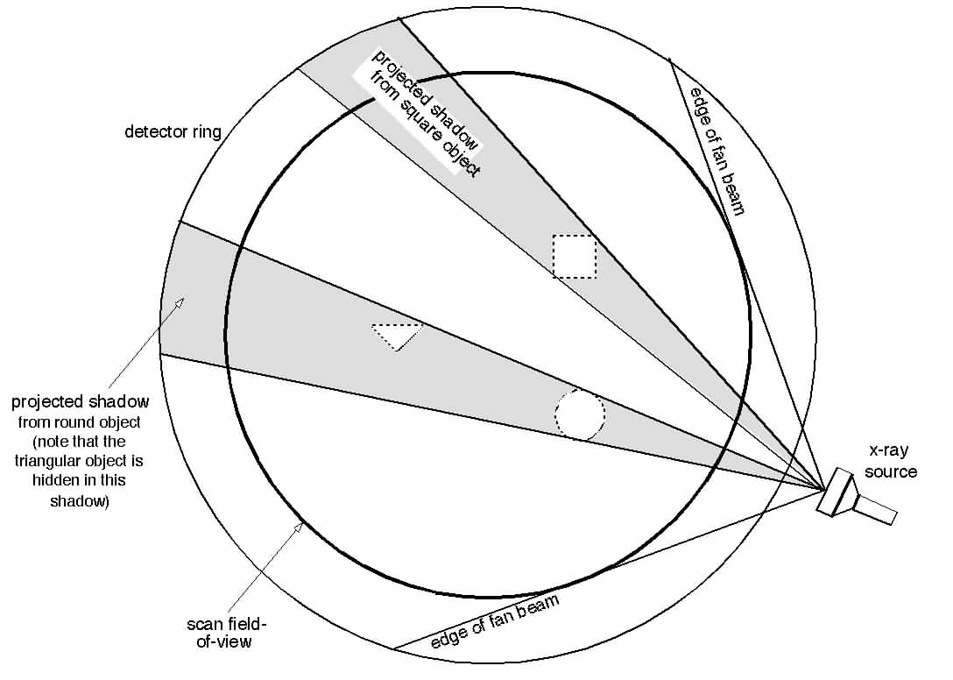
Images from Backprojection - 1
projection =
set of ray sums collected at the same time (iso-time)
ray sum =
data from one detector during one integration period

Slide 18
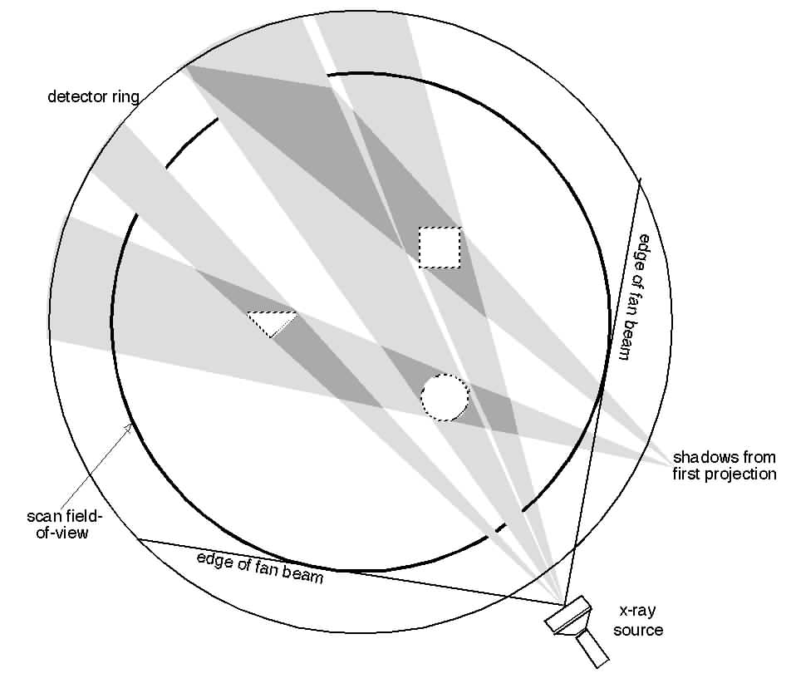
Images from Backprojection - 2

Slide 19
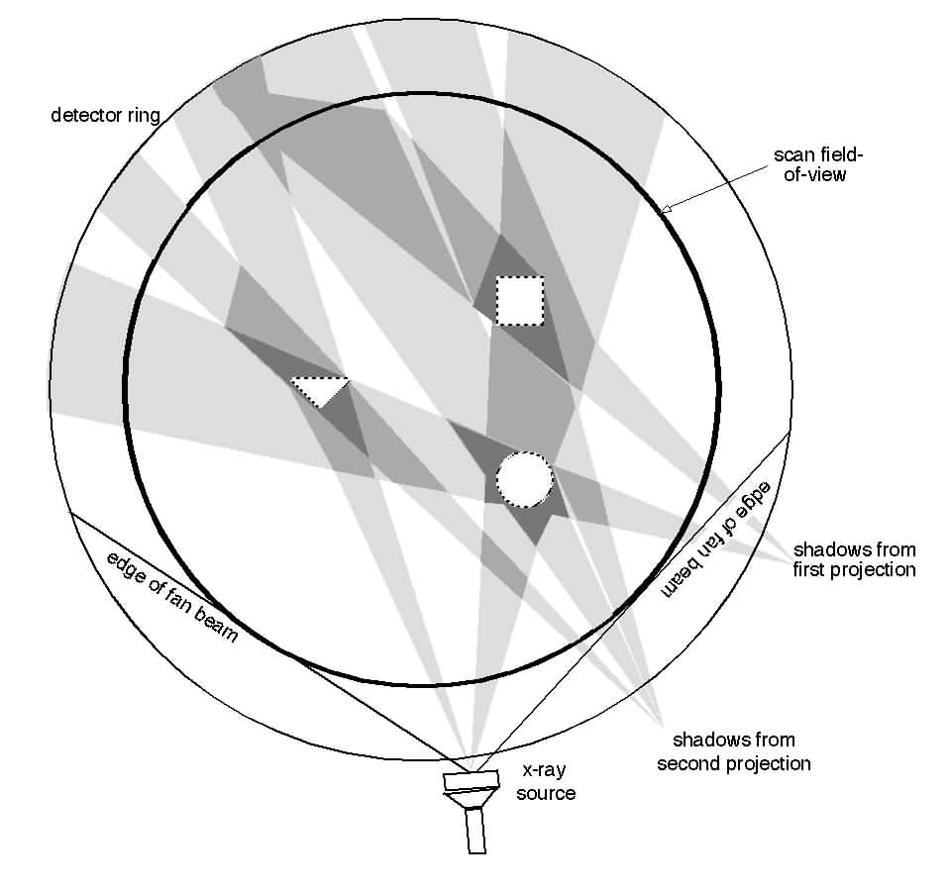
Images from Backprojection - 3

Slide 20
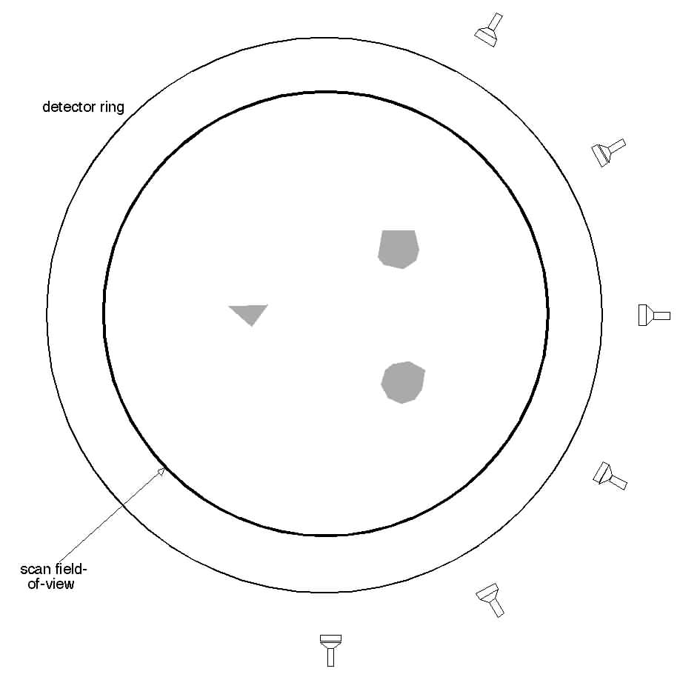
Images from Backprojection - 4
Collect projections around 360 degrees
4800 projections in full field

Slide 21
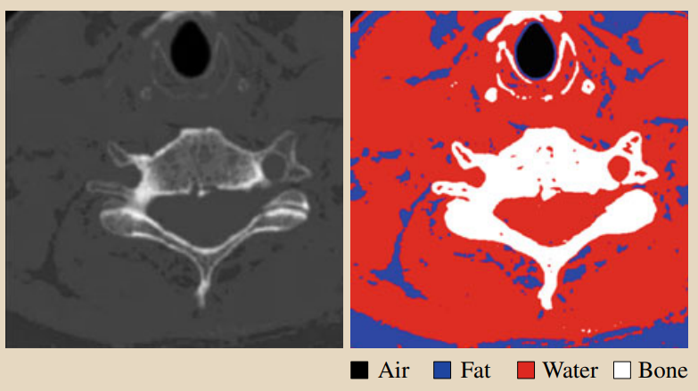
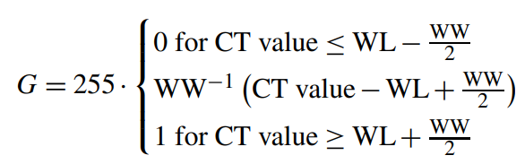
WW, window width
WL, window level
Notes:
Thresholding of a CT slice. The CT slice in the area of the spine can be statically segmented because the standardized Hounsfield units (HU) allow the definition of windows for different tissue such as bone [200 ... 3000], water [−200 ... 200], fat [−500 ...−200], and air [−1000 ...−500]
Figure 16.8b,c shows the corresponding piecewise linear function for a bone window (WL = +300 HU, WW = 1500 HU) and a soft tissue window (WL = +50 HU, WW = 350 HU), as well as their effects on the representation of an abdominal tomogram

Slide 22
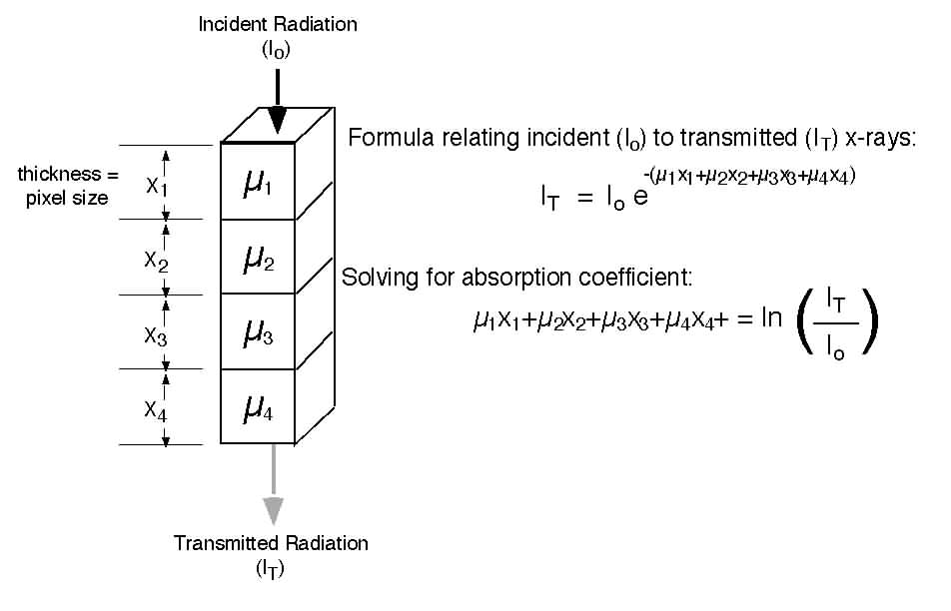
Ray sum

Slide 23
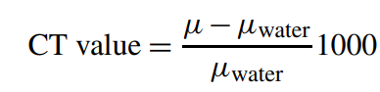
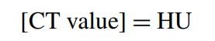
Attenuation values
Attenuation values μ are represented as gray values
Are related to the attenuation value of water
In honor of Hounsfield, the unit of these values,
Notes:
Attenuation values are transformed onto a dimensionless scale and are related to the attenuation value of water.
On this scale, the CT value of −1000 HU is assigned to air and the CT value 0 HU to water.
In principle, this is an open-ended scale, but in practice it ends at ≈ 3000 HU. The range of 4000 HU overall can be captured quite well by means of 12-bit gray-value images. This scaling is arbitrary, but nevertheless has practical consequence

Slide 24
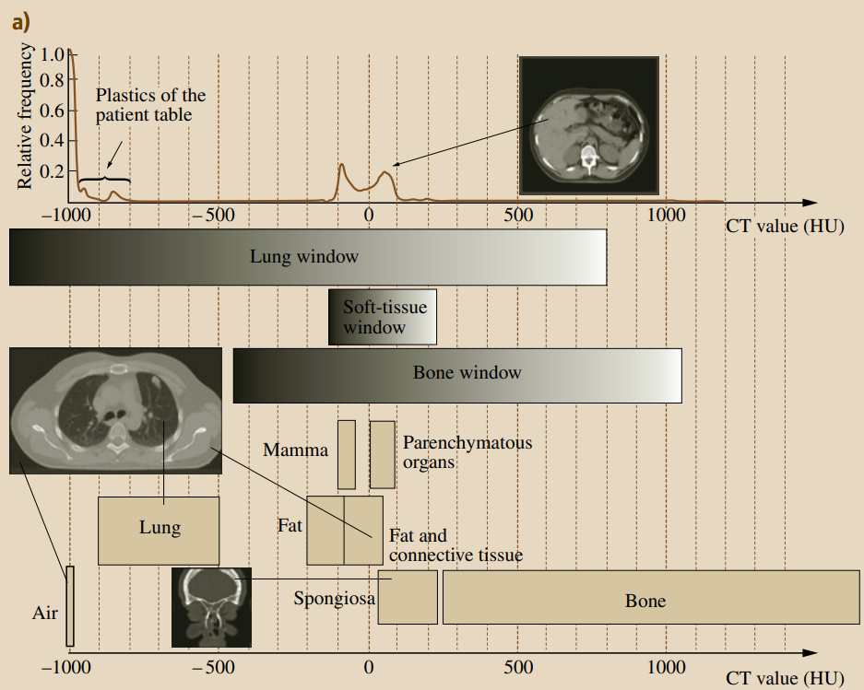
Notes:
Attenuation values in Hounsfield units (a). The data are compiled from the collections in [16.18]. The principle of windowing. The complete interval of practically sensible Hounsfield values (HU), ranging from −1000 HU up to 3000 HU (relative frequency of the values for the abdomen area – lower left), cannot be recognized and distinguished by the human visual system. Therefore, the different anatomically interesting Hounsfield intervals have to be mapped to appropriate grayscale intervals that can be differentiated. The lower right image provides the characteristic curves for two anatomically relevant windows. The upper images show the result of the bone window

Slide 25
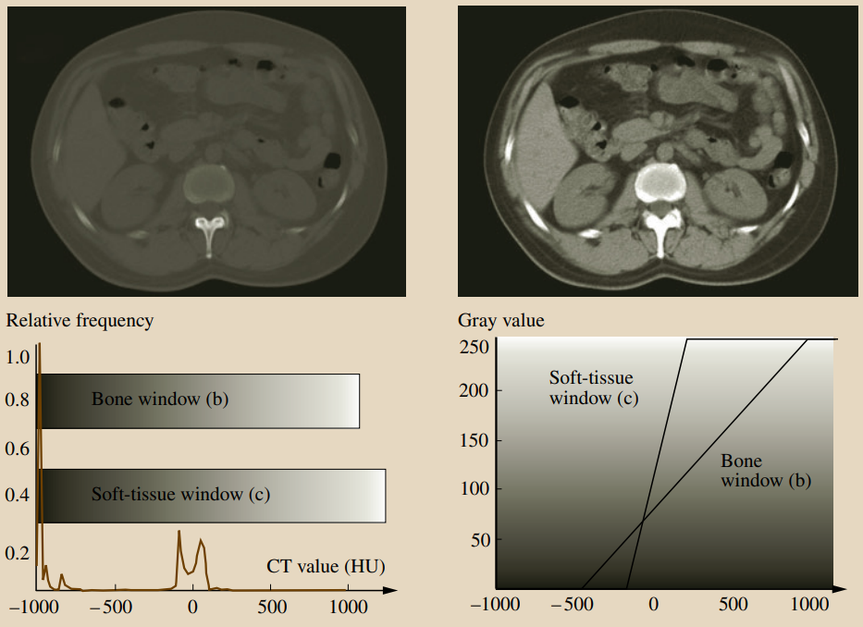
Notes:
WL = +300 HU, WW = 1500 HU) and the soft tissue window ((c): WL = +50 HU, WW = 350 HU)

Slide 26
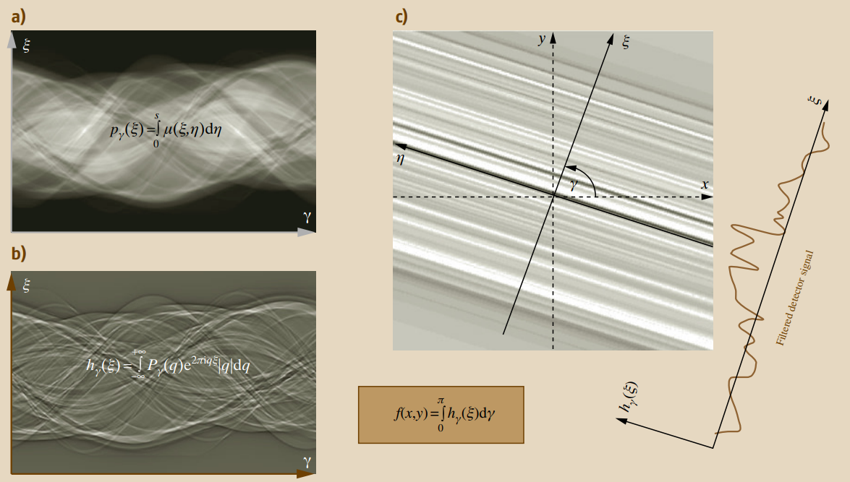
Notes:
Projection profile in the direction γ of the measurement of P_{γ} (ξ).
The result of the high-pass filtering of the measured attenuation profile pγ (ξ) is illustrated in Fig. 16.6b. It can be seen that the sinusoidal structure of the data is preserved.
However, due to the high-pass filtering, only changes of Pγ (ξ) are represented by hγ (ξ).

Slide 27
